Slide 1


Sliding Into the MLB
Presented by: Anthony Heimpel & Leishka Marrero

Slide 2

Predicting Homeruns
In a game based on numbers, we want to know how a player's statistics impact how many homeruns they will hit a year.
Our goal is to create a model that will predict how many homeruns a player can hit based on their age, weight, height, hits, and which side they bat on.

Slide 3

Lahman Baseball Database
The updated version of the database contains complete batting and pitching statistics from 1871 to 2022, plus fielding statistics, standings, team stats, managerial records, post-season data, and more.

Slide 4
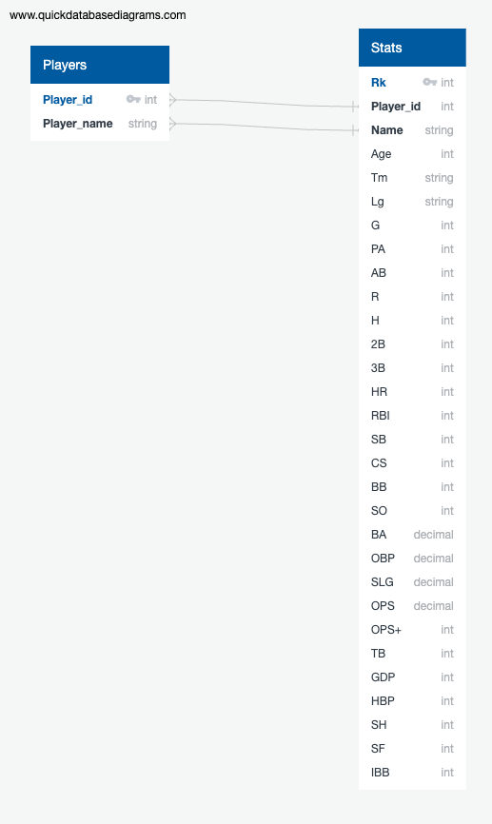
ER Diagram

Slide 5
Technologies, Languages, Tools, & Algorithms

Slide 6
Data Exploration
Years of Data
2019, 2020, 2021, 2022
Total Number of Players
2181
# of Players per Year
2019: 578
2020: 440
2021: 591
2022: 572
Age Range
22 - 43
Height Range
66in – 79in
Weight Range
140lbs – 282lbs
Total Homeruns
20,124

Slide 7
Age vs. Homeruns

Slide 8
Weight vs. Homeruns

Slide 9
Height vs. Homeruns

Slide 10
Bats (S, L, R) vs. Homeruns

Slide 11
Hits vs. Homeruns

Slide 12
Recommendations for Future Analysis

Slide 13
Any Questions

